Slide 1
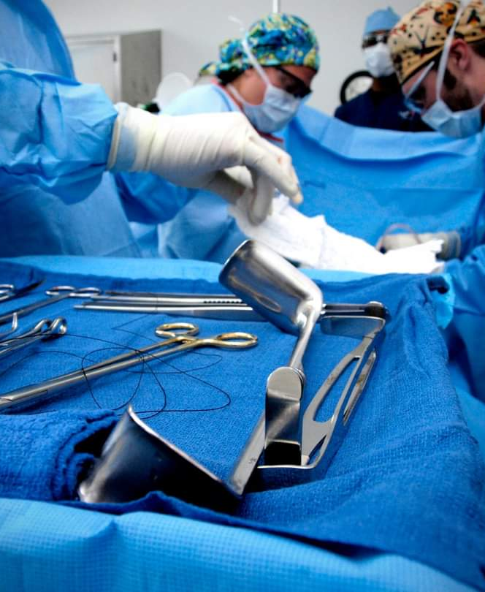
Strengthening student communication skills through trauma simulation
Crystal Warner, sa-c, csa, cst, fast

Slide 2
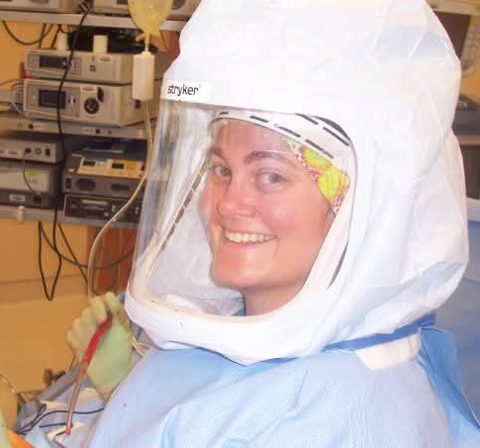
bio
2007-CST, 2008-CSA, 2025 SA-C
2010-2018 – Education OH, FL, AL GA, TX, CO
2007-2020 – Practitioner OH, IN, FL, AL, GA, CA, KY
2018-Current – Account Manager, Sales
2020-2024 – ARC/STSA-Education Manager
2024-Current – Consultant, SPD Instructor
2025-Current – ST PD, Co-Founder AISE

Slide 3
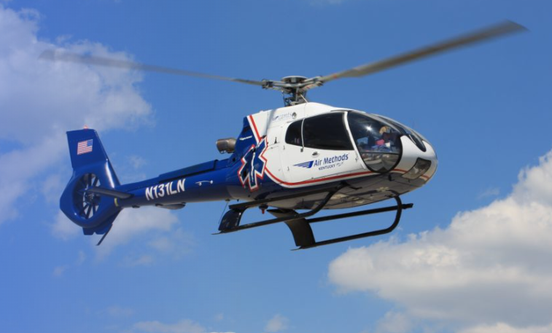
objectives
Show teaching strategies for maintaining clarity and calmness during critical incidents.
Highlight how trauma simulations encourage teamwork between different roles.
Develop active listening skills to respond appropriately to dynamic scenarios.
​
Demonstrate how simulation exercises replicate high-pressure environments.​

Slide 4
Where the idea came from
Community feedback
experience
Clinical preceptor evaluations

Slide 5
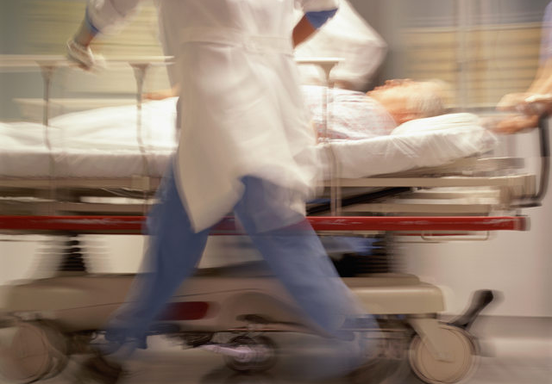
The role of trauma simulation
What is trauma simulation?​
Benefits for Communication & Teamwork
Evidence based outcomes from simulation training

Slide 6
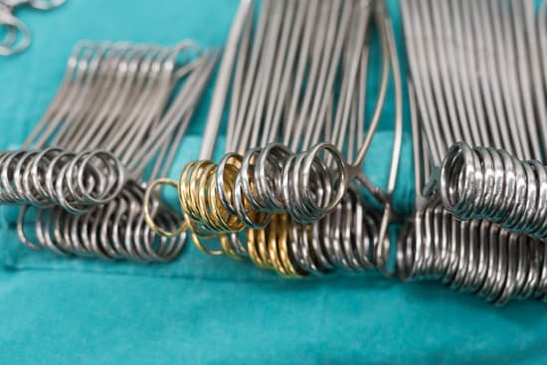
What is trauma simulation?
*Critical component of surgical training
*Utilizes various techniques to enhance skills
*Replicate real-world trauma scenarios

Slide 7
Benefits
Enhanced team communication and collaboration
Allows students to practice and refine skills in a controlled environment
Improved patient outcomes
Reduced medical errors and complications
Hands-On practice and retention

Slide 8
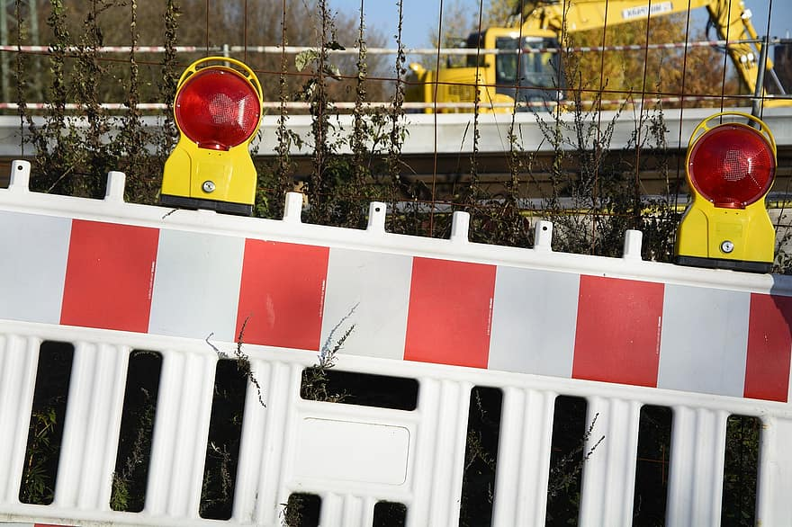
Communication Challenges
Lack of clarity in roles
Stress induced errors
Information overload
Personality differences

Slide 9
communication Strategies
Teamwork in Action
Closed-Loop communication
Active Listening
Clear role assignments
Confirmation
Error Prevention
Shared Understanding
Be Fully Present
Non-Verbal Cues
Withhold Judgement​
Defined Scope
Accountability
Reduced Conflict

Slide 10




Set it up
Assign “Call team”
Prep the lab
Surgical Tech
Circulator
Surgical Assistant
Anesthesia
Choose the procedure
Create preference card and pull supplies
Prepare the patient
Go Time!
debrief
Circulator ​receives text
30-minute timer set
Procedure performed
Constructive feedback
Open-ended questions
“What went well?”
“What could we have done differently?”​

Slide 11
Essential Mock Trauma Supplies
Positioning Aids
Patient
Case Cart
chaos
Manikin
Procedure Card
Specify
Keep it real
Organ/Specimen
Tubes/Drains/IV
Include HOLD items
Add patient allergies
Don’t always use supine
Blood
Loud music
Speed

Slide 12
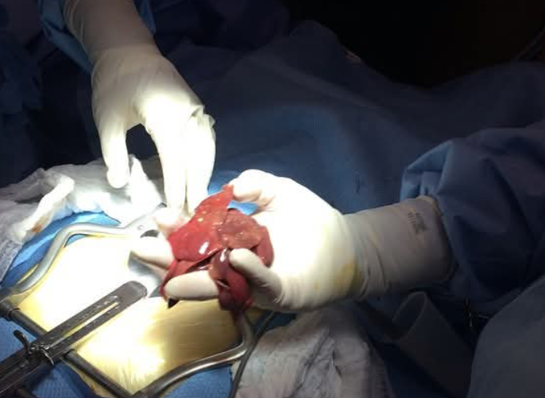
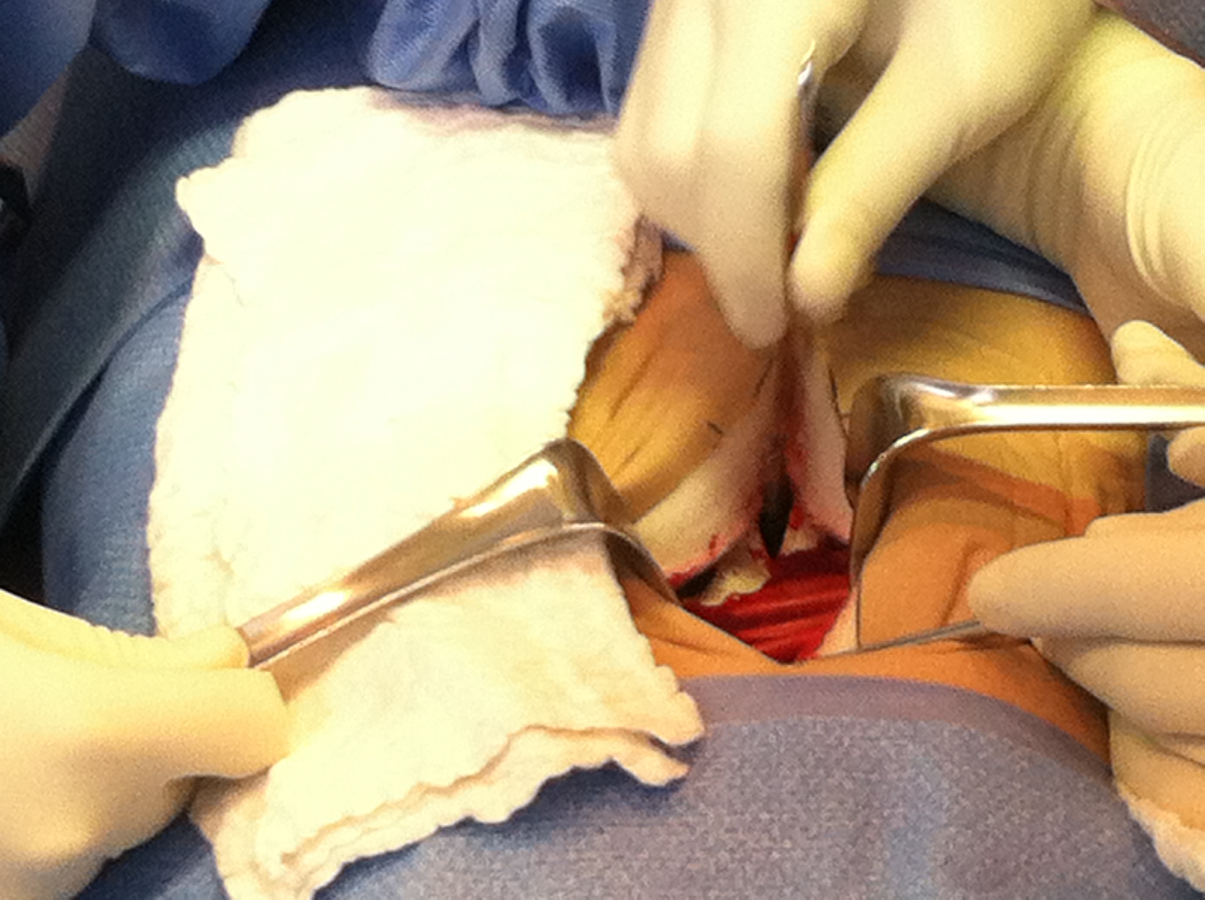
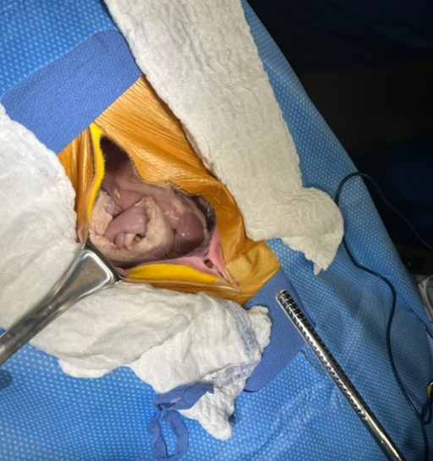
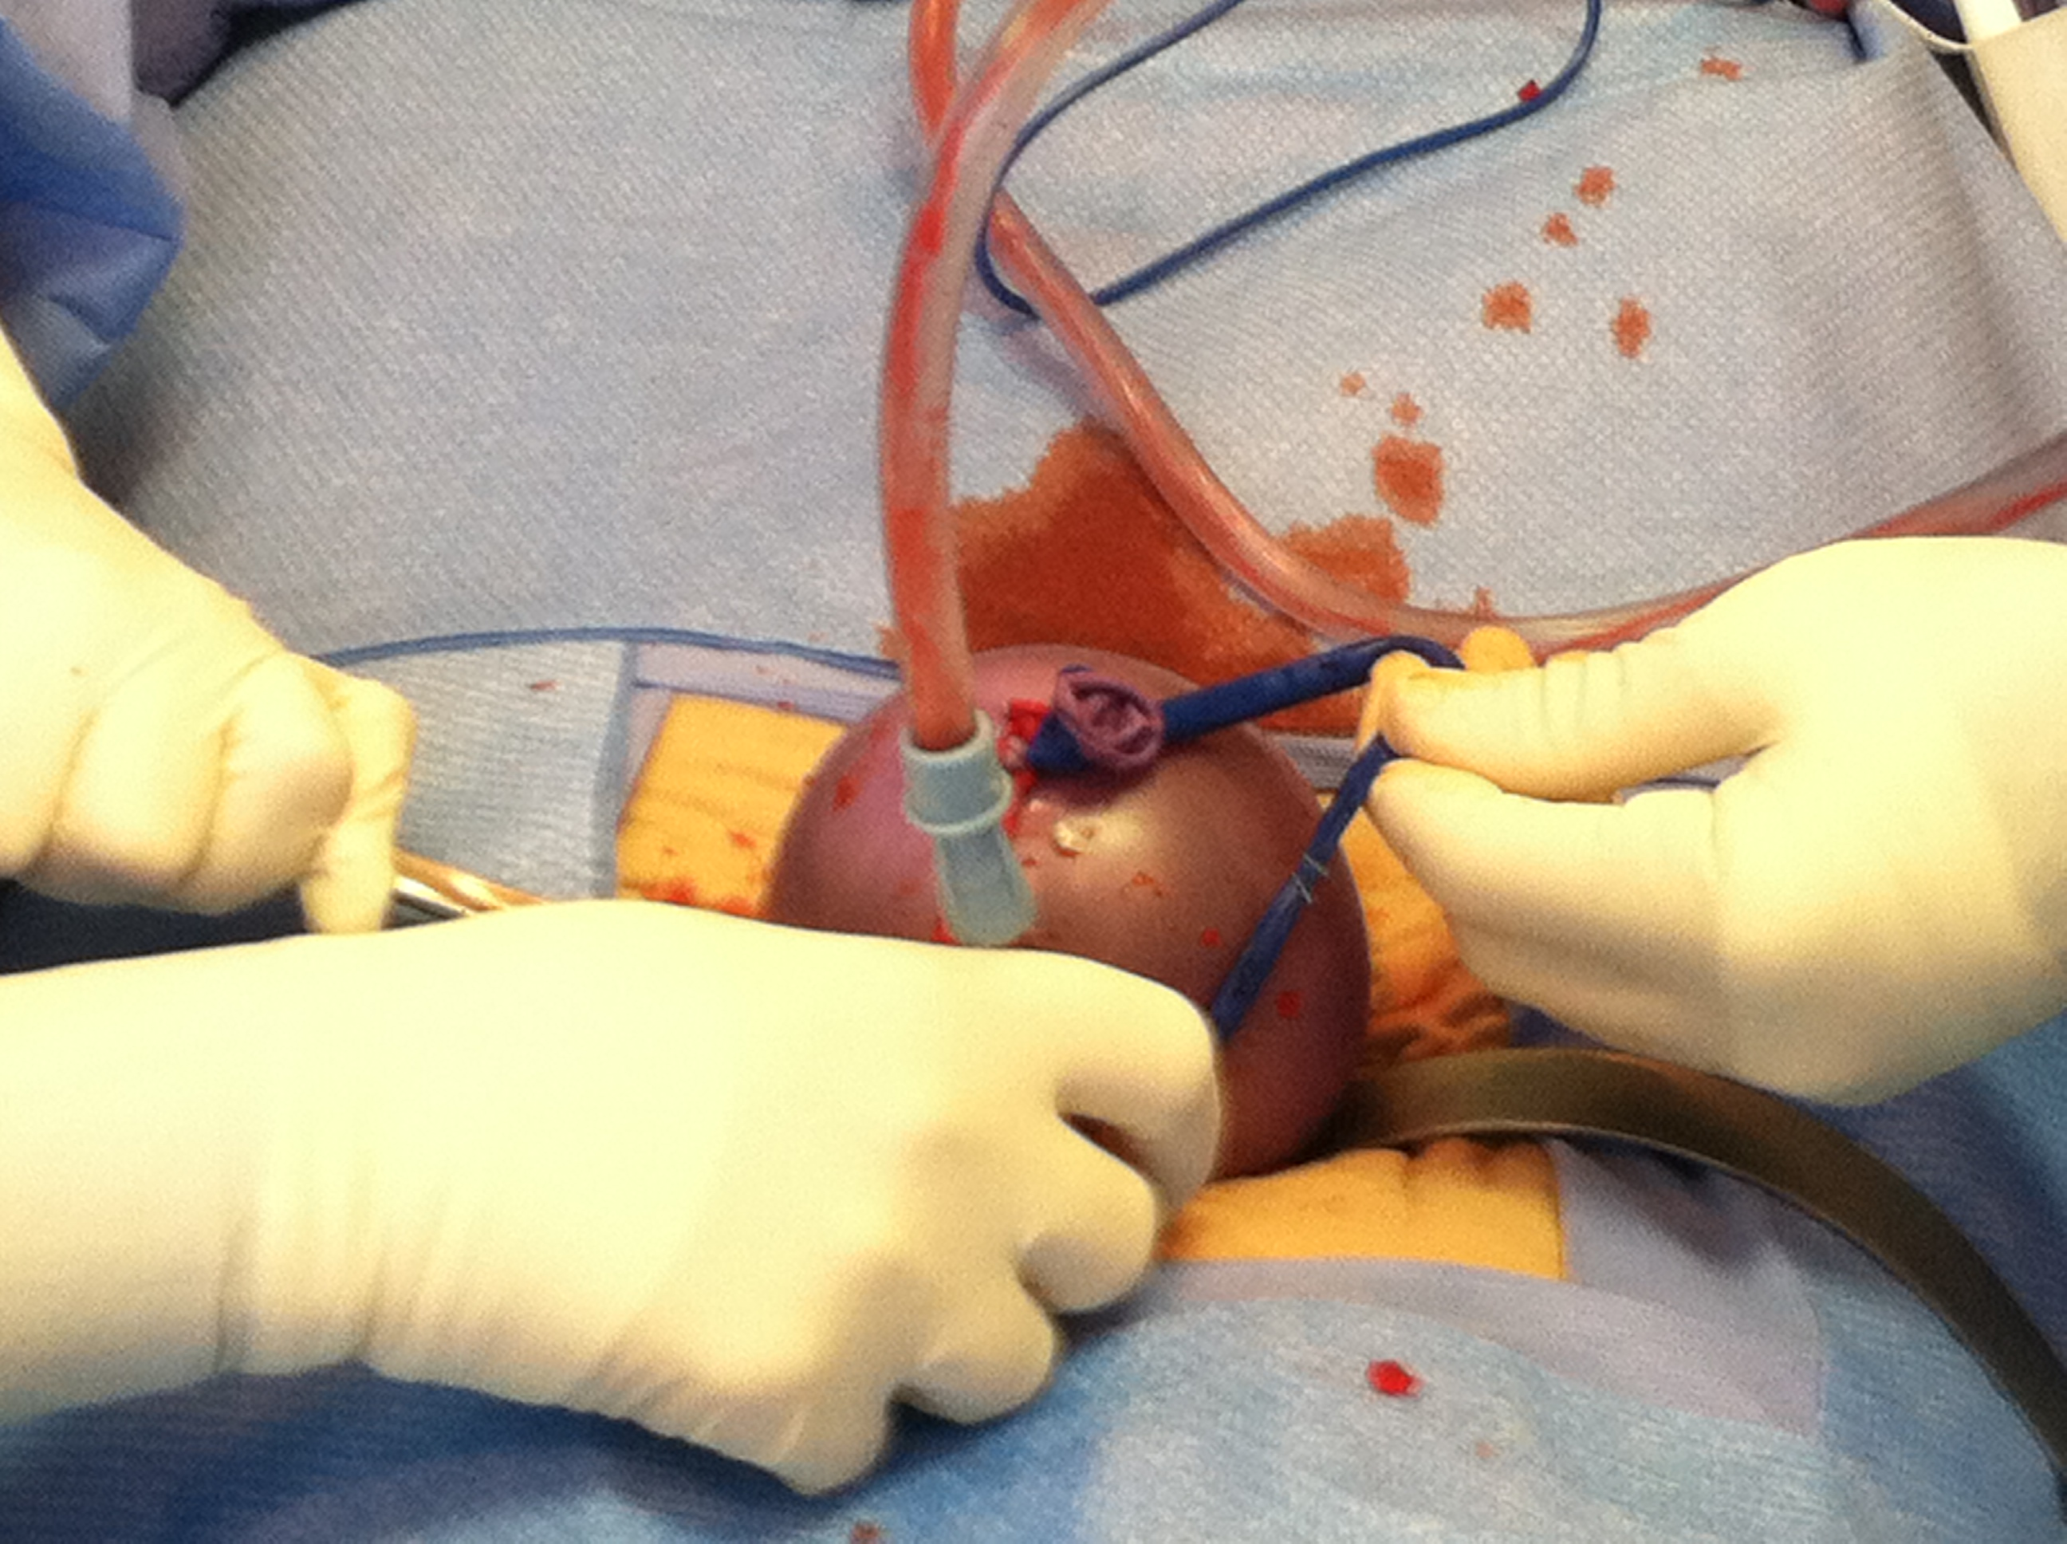
Keeping it realistic

Slide 13
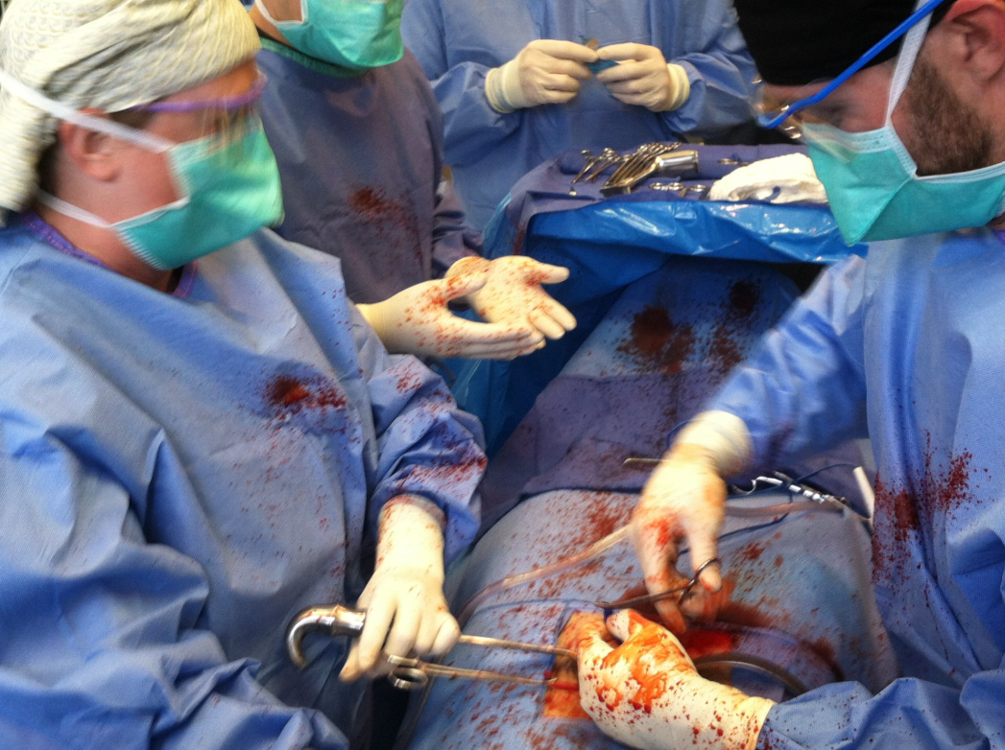
Students in action

Slide 14
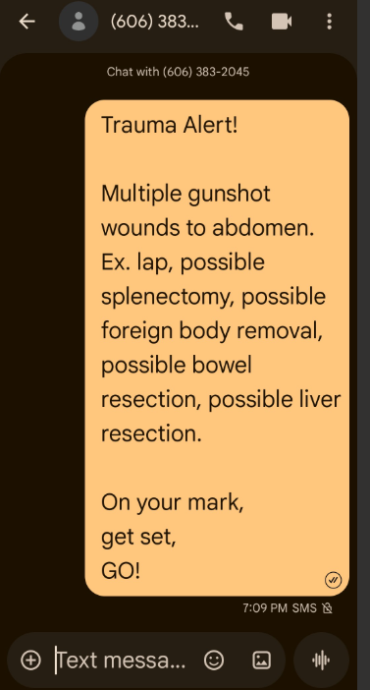
Sample case
Oh, the possibilities!!
​”The more you practice thinking on your feet and the more you prepare for future scenarios, the better you get at improvising when they arise.”
-Roger Spitz

Slide 15
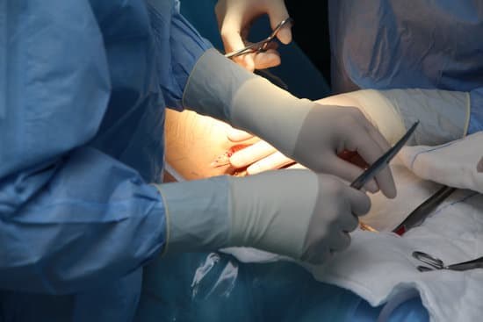
Summary
Trauma simulation builds confidence, communication clarity, and the ability to improvise effectively – critical skills for any fast-paced clinical environment

Slide 16
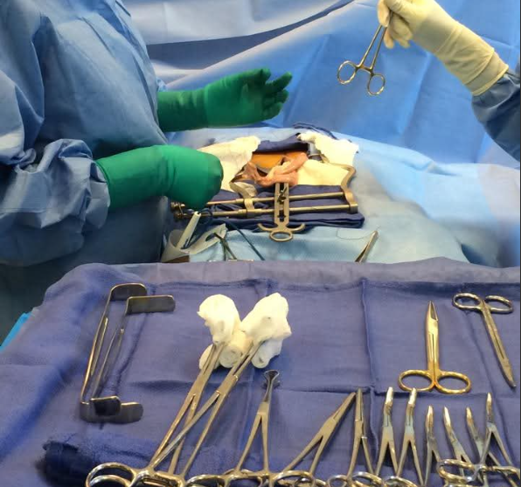
Thank you
Crystal Warner, SA-C, CSA, CST, FAST
warnercl@roanestate.edu

